Slide 1
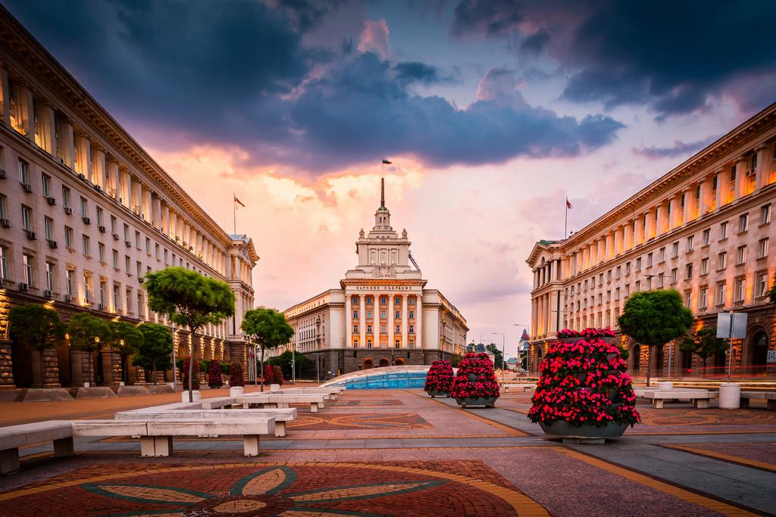

Viktor Velev, Vladislav Georgiev, Kaloyan Madjunov
Martin Datsev, Petar Milev, Telerik Arsov

Slide 2


THE PROBLEM
The difficult tourists orientation in Sofia
The difficulty of finding a place to live

Slide 3
THE SOLUTION
Fast user friendly analysis of Sofia
Population density
Sport facilities
Best quarters to live in

Slide 4
THE TECHNOLOGIES
NLTK
NumPy
Selenium
GloVe – Stanford NLP
GenSim
Pandas
TextBlob

Slide 5



THE DATA ASSIMILATION
Airbnb API
Tripadvisor API
Dataset with a polyon of the quarters in Sofia

Slide 6
EXPLORING THE DATA
Sentiment analysis
Topic modelling
Scoring locations by topics
Categorical Search

Slide 7
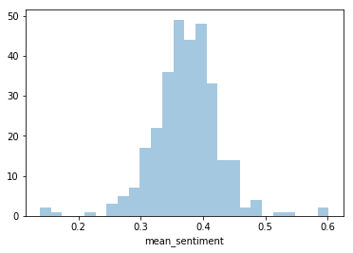
Sentiment Analysis

Slide 8
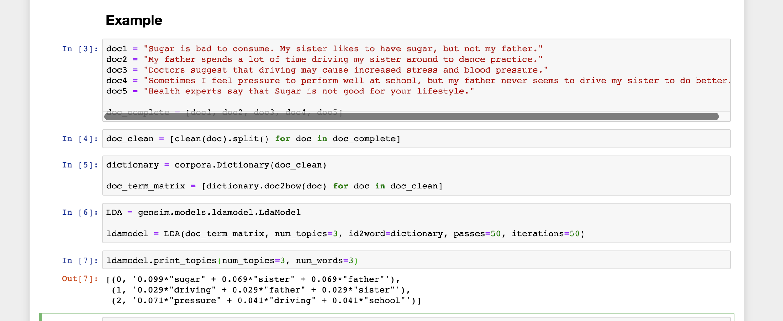
Topic Modelling

Slide 9
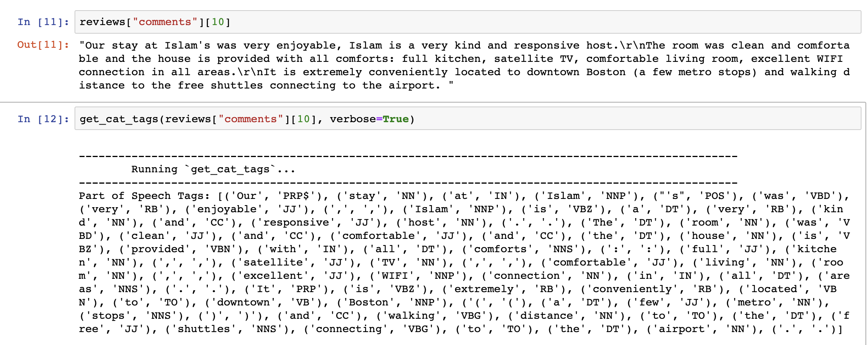
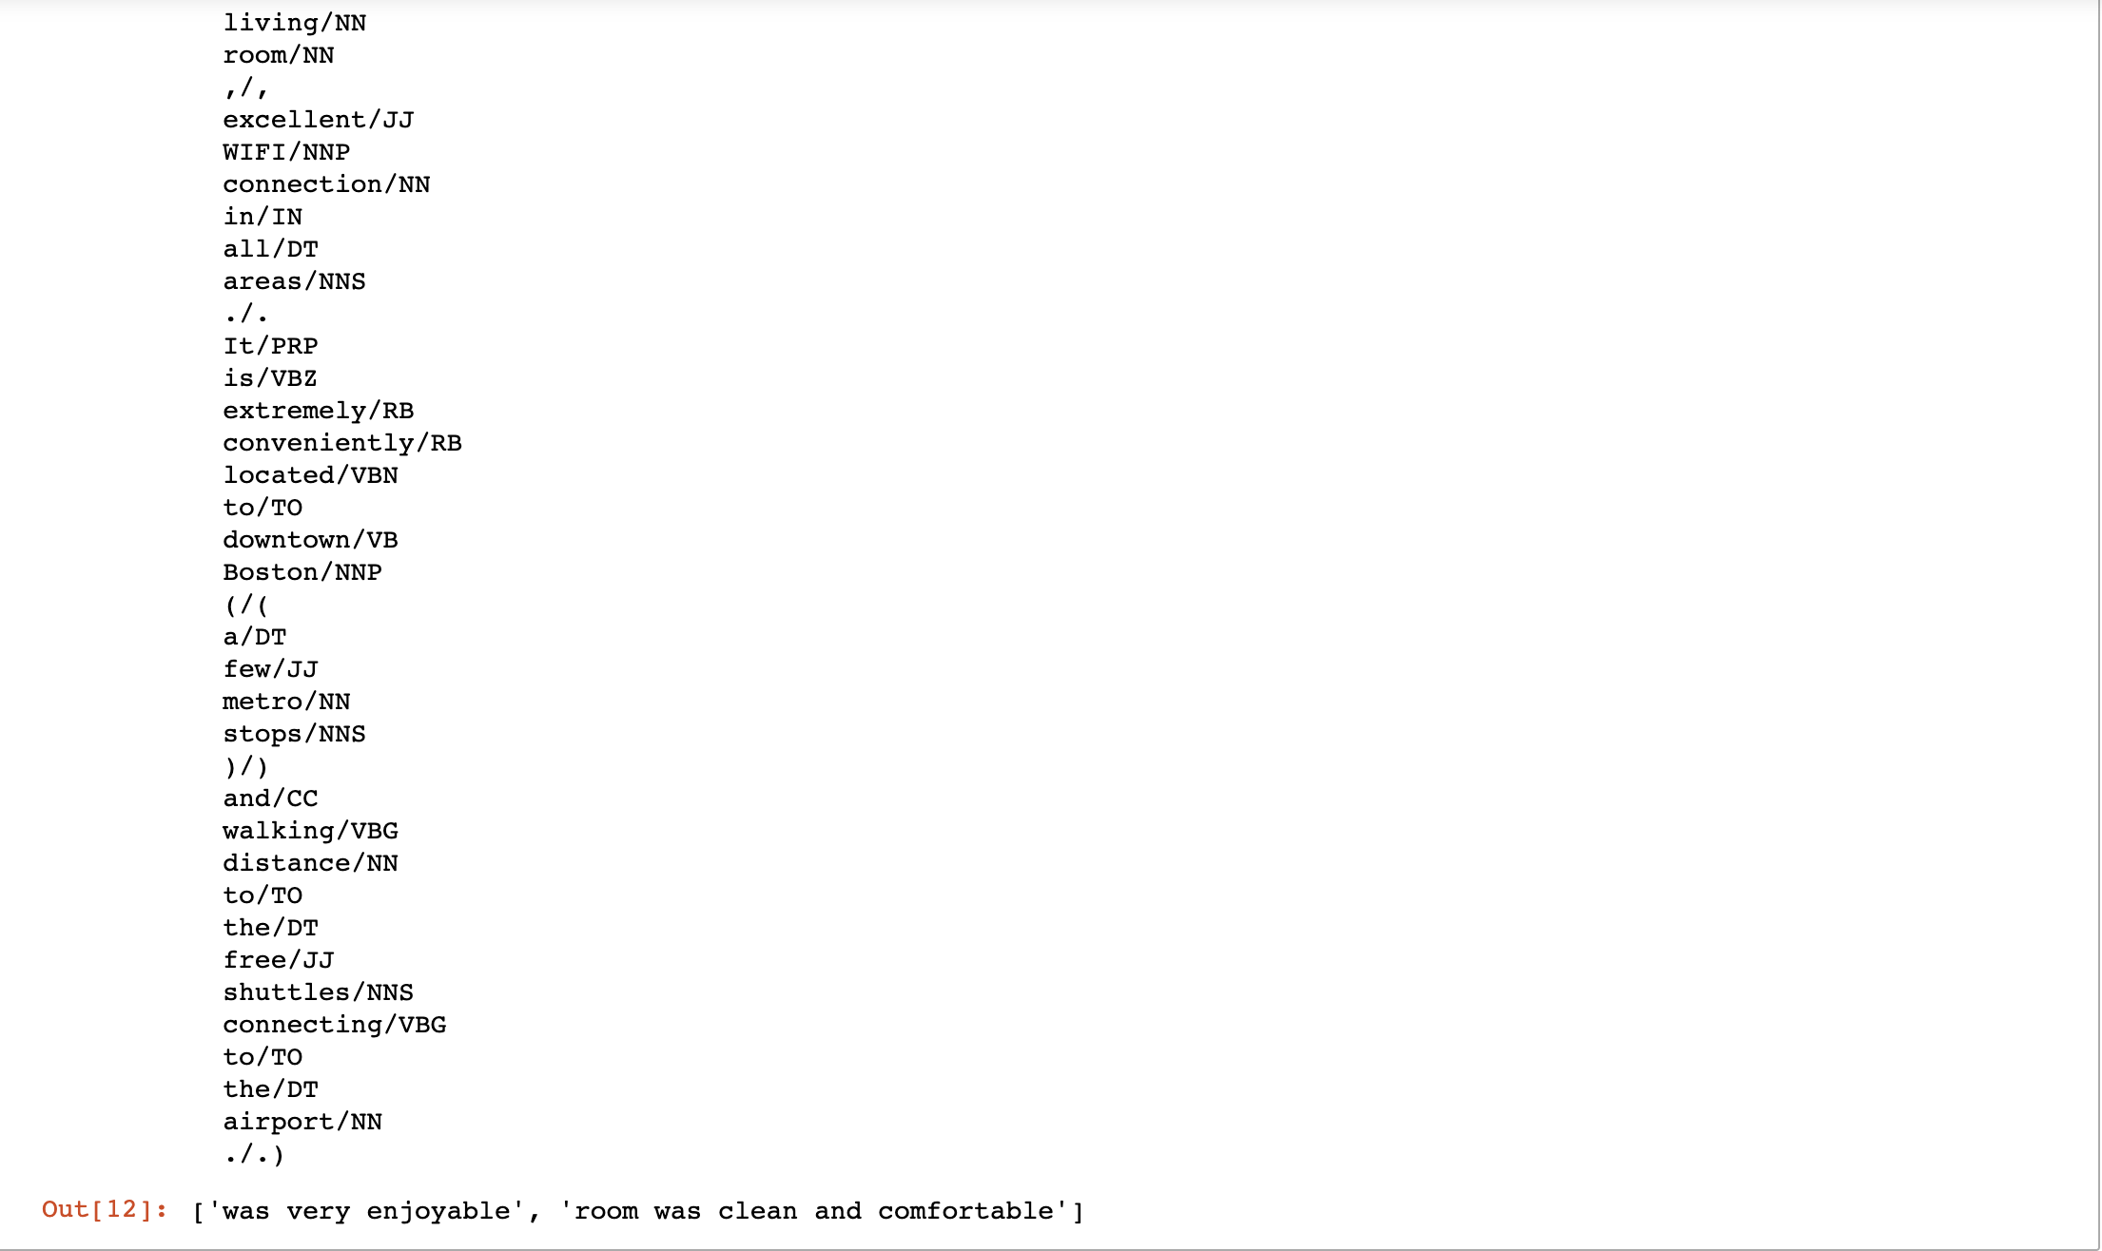
Categorical Search - demo

Slide 10
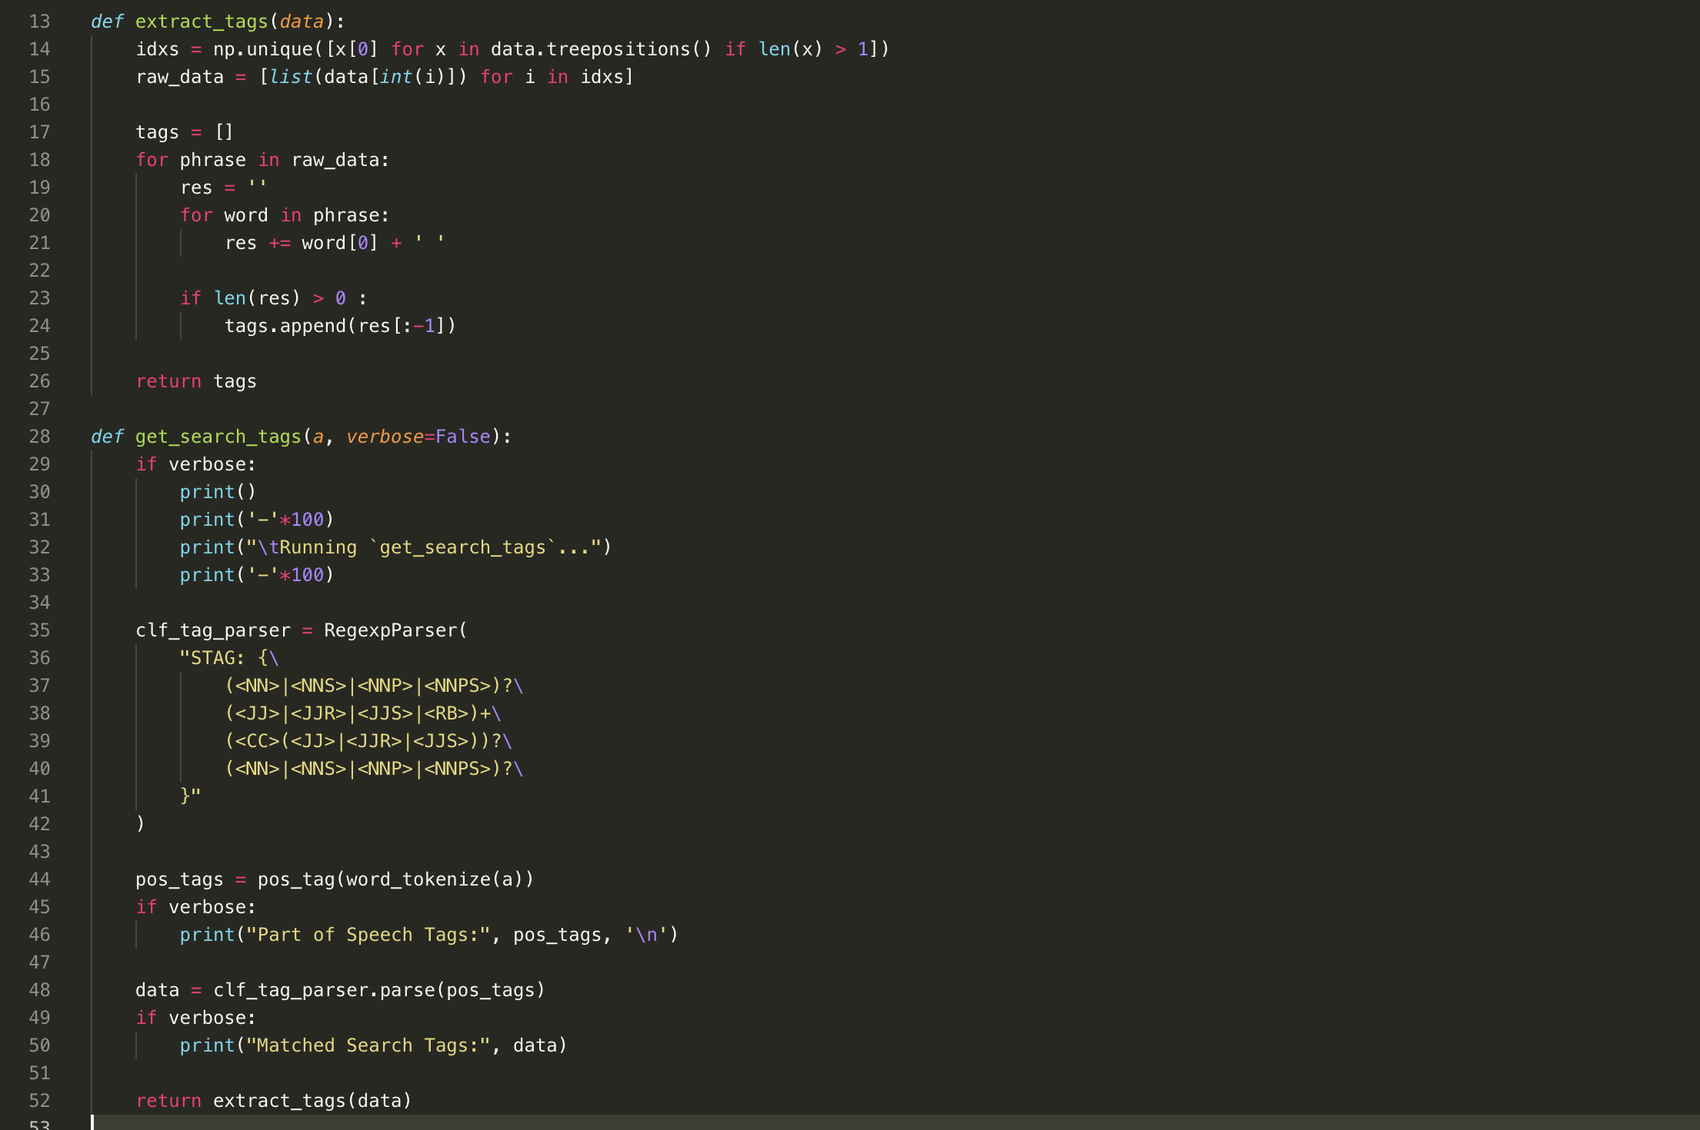
Categorical Search - implementation

Slide 11
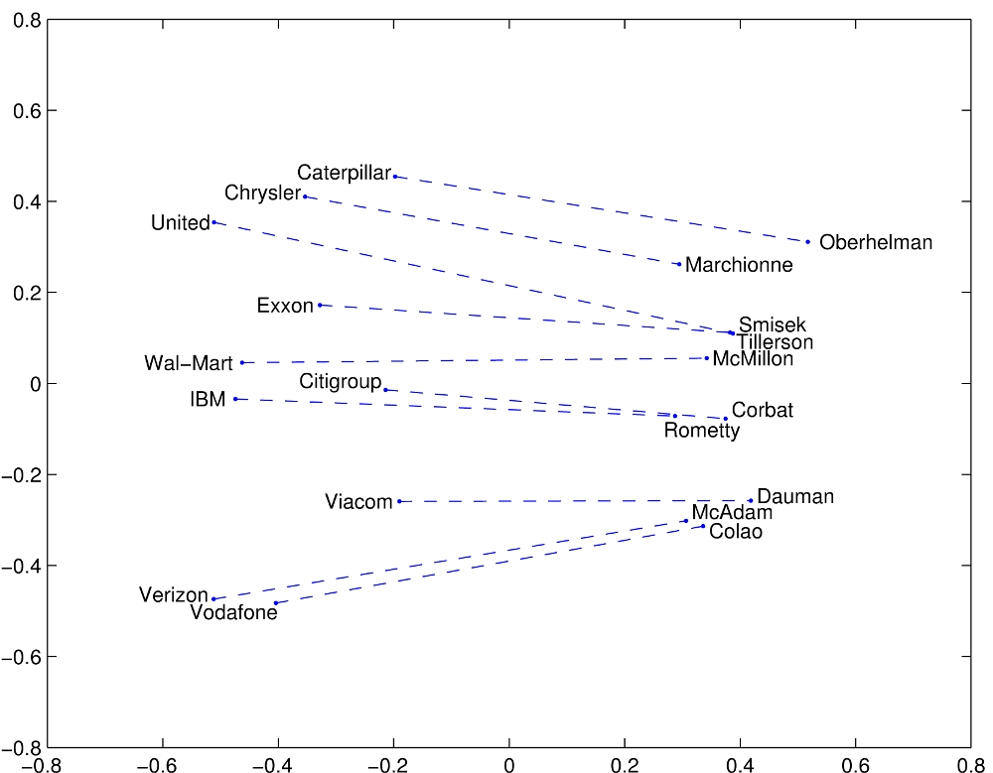
A HUMAN-LIKE SEARCH
Natural input
Search terms extraction
Comparing by meaning

Slide 12

TIME FOR DEMO

Slide 13




Slide 14


